Slide 1
AI-DRIVEN CROP DISEASE PREDICTION AND MANAGEMENT SYSTEM
CAPSTONE PROJECT PRESENTATION
Group No:- 238
Project Guide:-
Mr. Mahipal Singh Papola
TEAM MEMBERS
Kamada Akshay Satya Sai Varma 12114737
Punukollu Gowtham 12112183
Gowrav Punukollu 12112181
Allapuram Vijay Vardhan 12108102
Guruju Yashwanth Kumar 12104928
Harshavardhan Bodanaboina 12103586

Slide 2
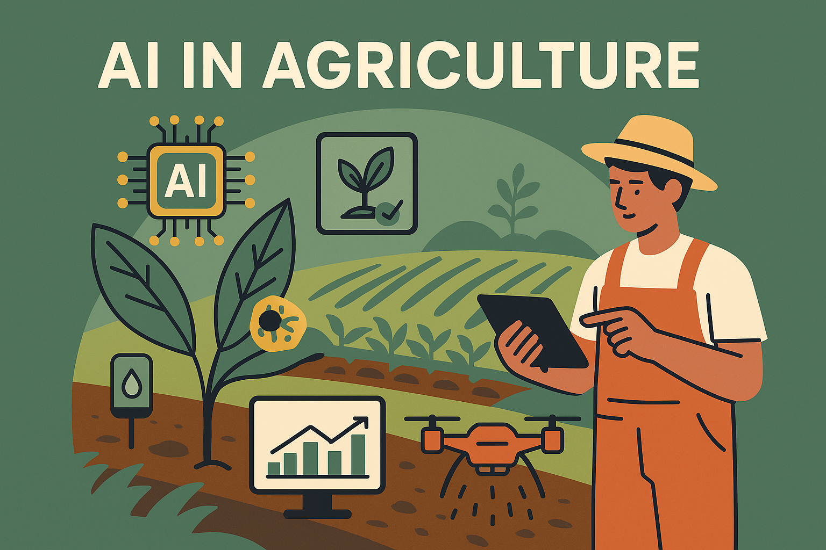
INTRODUCTION
Agriculture’s Challenges
Agriculture remains the backbone of many economies, particularly in developing nations.
Increasing global population exerts pressure to produce more with limited resources.
Key Issues in Modern Farming
Crop diseases cause 20–40% crop losses globally.
Inefficient irrigation leads to water wastage or undernourished crops.
Role of AI in Agriculture
AI, especially Deep Learning, offers precise, real-time solutions for complex agricultural issues.
Computer vision enables early disease detection via leaf image analysis.
Machine learning predicts crop-specific irrigation needs based on real-time environmental data.

Slide 3
PROBLEM STATEMENT
Agriculture, particularly in developing regions, faces severe threats due to the growing challenges of crop diseases and inefficient irrigation. Despite the critical role it plays in food security and economic stability, the sector remains vulnerable due to its reliance on traditional methods.
Crop diseases continue to be a major cause of yield loss, primarily because their detection often depends on manual visual inspection by experts, an approach that is slow, error-prone, and not scalable. By the time a disease is visually identified, it may have already caused irreversible damage, resulting in financial losses for farmers and affecting the food supply chain.
At the same time, water management in agriculture is often suboptimal. Traditional irrigation practices do not account for dynamic environmental conditions such as soil moisture levels, humidity, or temperature. This leads to either overwatering, which wastes a critical resource and harms crop roots, or underwatering, which stunts growth and reduces productivity.
These challenges are intensified in rural areas where smallholder farmers, who constitute the majority, lack access to modern technological tools. Without affordable and easy-to-use systems, they are left to depend on outdated practices that cannot keep pace with the demands of modern agriculture.
This project aims to address these issues by developing an AI-driven system that can predict crop diseases and recommend optimal irrigation in real time. By leveraging computer vision and machine learning, the system empowers farmers to make informed decisions, minimize crop loss, conserve water, and improve agricultural sustainability.

Slide 4
REVIEW OF LITERATURE
Recent years have seen substantial progress in applying artificial intelligence (AI) and machine learning (ML) to agricultural challenges. A significant body of research has focused on plant disease detection using computer vision. Traditional techniques relied on manual image inspection or basic image processing algorithms, which were limited by inconsistencies in lighting, background noise, and leaf appearance.
With the rise of deep learning, Convolutional Neural Networks (CNNs) have become the gold standard for image classification tasks. Ferentinos (2018), for instance, demonstrated over 99% accuracy in identifying plant diseases using CNNs trained on the PlantVillage dataset. Lightweight architectures like MobileNetV2 are now being adopted for real-time classification on mobile and web platforms, providing the accuracy of deep networks with reduced computational demands.
In parallel, water conservation and efficient irrigation have emerged as key areas where ML can make a difference. Studies have used regression models, particularly Random Forest Regressors and Support Vector Machines, to predict crop water needs based on environmental inputs such as soil moisture, temperature, and weather forecasts. These models have outperformed manual scheduling methods and are better suited to dynamic agricultural environments.
IoT integration in agriculture has further improved the reliability of real-time data collection. Sensors can now capture field-level conditions, feeding data directly into predictive models for disease detection and irrigation planning. Companies like AquaSpy and CropX are already leveraging this synergy between IoT and AI to develop intelligent precision farming solutions.
Despite these advancements, gaps remain, especially in systems designed for small and marginal farmers. Many existing tools are either overly technical or not tailored for diverse climatic and crop conditions. Moreover, user-friendly platforms that combine disease detection and irrigation advice are still rare.
This project builds on these foundations, combining proven CNN and ML models into a single, accessible web platform, aimed at empowering farmers with real-time, actionable insights.

Slide 5
RESEARCH GAPS
Many AI models (e.g., VGG16) are resource-heavy and impractical for small-scale farmers or mobile platforms.
Most tools focus on either disease detection or irrigation, not both, resulting in incomplete support for farmers.
Irrigation systems often ignore dynamic field conditions like humidity, soil moisture, and weather patterns.
Existing platforms are too complex or technical, limiting accessibility for users with minimal digital literacy.
Bridging these gaps with a unified, lightweight, and easy-to-use AI system for disease prediction and irrigation advice.

Slide 6
OBJECTIVES
🧠 Smart Disease Detection Leverage deep learning (MobileNetV2) to identify plant diseases from leaf images in real time.
💧 Intelligent Irrigation Planning Use Random Forest Regression to recommend optimal water usage based on environmental data.
🌐 Unified Web Platform Build a user-friendly web interface accessible on mobile and desktop, requiring minimal technical knowledge.
📊 Real-Time & Scalable Ensure real-time performance and allow easy scaling across different crops, regions, and environmental conditions.
👩‍🌾 Empower Farmers Deliver actionable insights to improve crop yield, save water, and promote sustainable agriculture.

Slide 7
PROJECT TIMELINE
January
Data Acquisition Plant leaf images are collected through the web platform, while environmental data (soil moisture, temperature, humidity) is gathered from IoT sensors in real time.
February
Disease Detection using MobileNetV2 Preprocessed images are fed into a lightweight CNN (MobileNetV2) trained on labeled leaf datasets to classify diseases accurately and efficiently.
March
Irrigation Recommendation using Random Forest A Random Forest Regression model processes real-time environmental data to generate crop-specific, optimized irrigation plans.
April
Web Application Deployment The complete system is integrated into a user-friendly Flask-based web app, allowing farmers to input images and data, and receive instant, actionable results.

Slide 8
SYSTEM ARCHITECTURE OVERVIEW
Data Collection
Leaf images captured via web interface
Real-time environmental data from IoT sensors (soil moisture, humidity, temperature)
Data Preprocessing
Leaf images are resized, normalized, and noise-filtered
Environmental data is cleaned and standardized for model input
Disease Detection Module
MobileNetV2 classifies leaf images into disease categories
Outputs a diagnosis with a confidence score
Irrigation Recommendation Module
Random Forest model predicts ideal water quantity based on current conditions
Uses temperature, humidity, soil moisture, and rainfall predictions
Web Platform Interface
Flask-based dashboard displays results instantly
Farmers can upload images, enter data, and view insights in real time

Slide 9
EXPERIMENTAL RESULTS
Dataset Used
Leaf image + sensor data; manually and IoT-collected
Disease Detection Results
MobileNetV2 – 96.3%, fast, real-time performance
Irrigation Prediction
RFR model – 0.89 R² score; accurate and scalable
Model Comparison
MobileNetV2 > VGG16 (speed); RFR > Linear, SVM
Output Showcase
Web Interface displays disease and irrigation predications

Slide 10
WEB APPLICATION (STREAMLIT)
1. Objective The web application provides an intuitive interface for users to interact with the disease detection and irrigation prediction models. It simplifies complex machine learning processes into user-friendly steps, enabling easy access for farmers, agronomists, and researchers.
2. Technology Stack Built entirely in Python using the Streamlit framework, the app supports rapid development and seamless integration with trained machine learning models. Streamlit allows real-time data input, processing, and output visualization without complex front-end coding.
3. Key Features
Input forms to enter symptom details or environmental parameters
Upload capability for plant leaf images for disease analysis
4. Deployment and Accessibility The application can be deployed locally or on cloud platforms like Streamlit Cloud or Heroku, making it accessible across devices such as desktops, tablets, and smartphones.
5. Impact
This web app empowers users by providing quick, reliable predictions, supporting informed decision-making for crop disease management and irrigation scheduling, thus enhancing agricultural productivity.

Slide 11
CHALLENGES AND LIMITATIONS
Data Collection Issues
Model Limitations
Hardware & Resource Constraints
Streamlit Deployment Challenges

Slide 12
FUTURE WORK & IMPROVEMENTS
Dataset Expansion
Collect more diverse and region-specific plant disease images
Include seasonal variations and rare disease cases
Expand environmental datasets from real-time IoT sensors deployed in varied locations
Model Enhancements
Experiment with Ensemble Learning or Vision Transformers for improved disease classification
Apply hyperparameter tuning to optimize Random Forest predictions
Implement auto-ML pipelines for model selection and tuning
Mobile & Offline Access
Develop a lightweight Android application for farmers in rural areas
Enable offline predictions by embedding the model within the mobile app
Streamlit App Improvements
Add multilingual support for better accessibility
Improve UI/UX with advanced layout features and faster file handling
Include feedback mechanisms for users to report prediction accuracy
Real-world Testing & Deployment
Pilot testing in agricultural fields with real-time feedback
Partner with agri-tech firms or NGOs for larger-scale implementation
Continuous learning loop from field data to retrain models

Slide 13
CONCLUSION
This project presents a robust and accessible solution to two significant agricultural challenges: plant disease detection and irrigation prediction. By leveraging deep learning models like MobileNetV2 and machine learning algorithms such as the Random Forest Regressor, we achieved promising results, including a disease classification accuracy of 96.3% and an irrigation prediction R² score of 0.89. These metrics validate the effectiveness of our models in controlled testing conditions.
To ensure usability beyond technical users, we developed a Streamlit-based web application that offers a clean, interactive interface for real-time predictions. Whether it’s uploading a plant image for diagnosis or entering environmental data for irrigation advice, the application bridges the gap between complex AI models and practical, everyday use in agriculture.
This system holds strong potential for real-world deployment, especially in rural areas where timely decisions can significantly impact yield and sustainability. It is a step toward building a smarter agricultural ecosystem—one that integrates AI, IoT, and user-friendly technology to empower farmers and agronomists alike.
While challenges such as model generalization and hardware limitations remain, the foundation laid by this project opens the door for future enhancements. With further data collection, model refinement, and mobile deployment, the system can scale into a highly impactful tool in the domain of precision agriculture.

Slide 14
ACKNOWLEDGEMENTS
We are especially thankful to our project supervisor, Mr. Mahipal Singh Papola, for their continuous encouragement, valuable feedback, and technical guidance. Their insights were instrumental in shaping the direction of our work.
Special thanks to our team members for their dedication and collaborative spirit, and to the online communities and open-source contributors whose tools and datasets made this project possible.

Slide 15

Thank You

